Slide 1
Expense Tracker
A comprehensive tool for managing personal finances using Java.

Slide 2
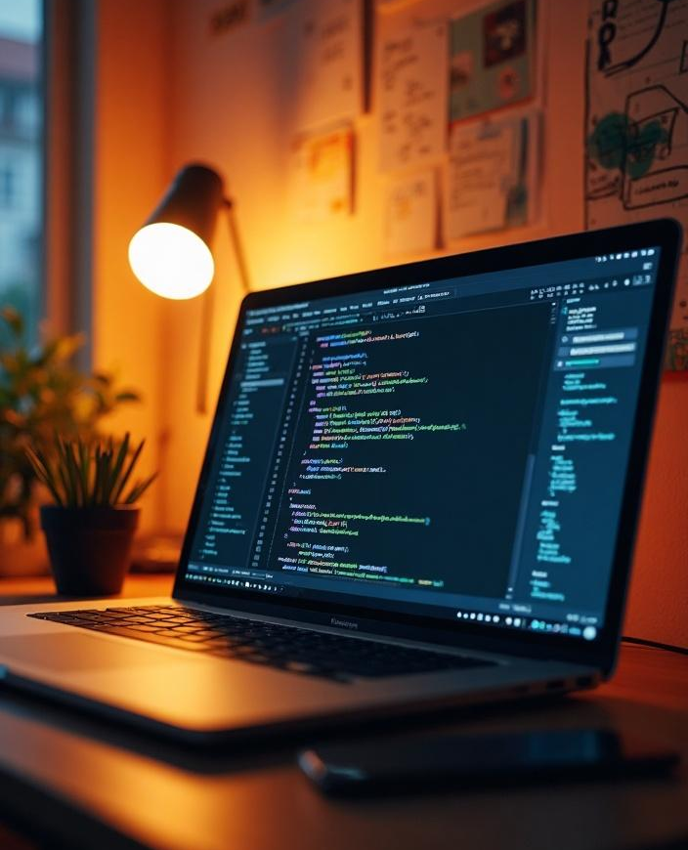
Introduction
This presentation outlines the development of an Expense Tracker application using Java, focusing on its objectives, features, and implementation details.

Slide 3
01
Project Overview

Slide 4
Objective of Expense Tracker
The primary objective of the Expense Tracker is to provide users with a reliable method to monitor and manage their daily expenses efficiently. The application aims to help individuals maintain budget control, track spending patterns, and promote financial awareness.

Slide 5
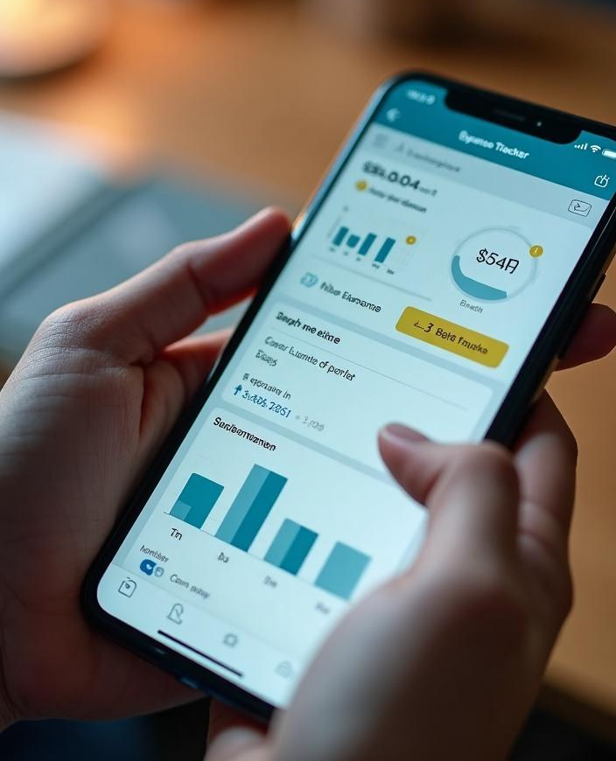
Key Features and Functionality
The Expense Tracker includes features such as user authentication, simple navigation, expense categorization, real-time expense tracking, and reporting capabilities. Users can add, edit, or delete expenses and generate reports to analyze spending habits over time.

Slide 6
Technological Stack Used
The Expense Tracker application is developed using Java as the primary programming language, leveraging the Java Standard Edition (SE) for core functionalities. The user interface is built using JavaFX to provide a modern and intuitive design. For data management, a SQLite database is employed to store user data securely and efficiently.

Slide 7
02
Implementation Details

Slide 8
Java Code Structure
The code is organized into multiple packages, each responsible for different aspects of the application. The main package handles the core functionality, while other packages encapsulate the user interface components, database interactions, and utility classes. This modular structure promotes maintainability and scalability of the application.

Slide 9
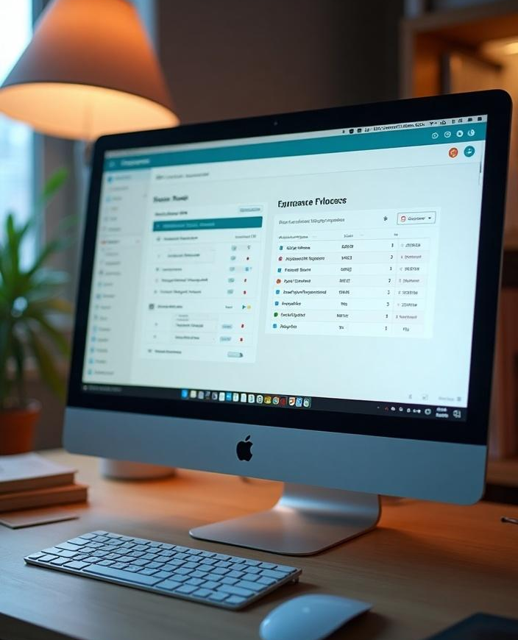
User Interface Design
The user interface is designed with usability in mind, featuring a clean layout that enhances user experience. Navigation is straightforward, with clearly labeled buttons and sections. The use of JavaFX allows for responsive components, ensuring that the application works seamlessly across different screen sizes and resolutions.

Slide 10
Data Management Techniques
Data management is crucial for the Expense Tracker, implemented through effective use of SQLite database queries for storing, retrieving, and updating expense records. Prepared statements are used to prevent SQL injection attacks and ensure data integrity. Additionally, the application incorporates exception handling to manage errors gracefully during database operations.

Slide 11
Conclusions
In conclusion, the Expense Tracker is a robust application that utilizes Java and modern technologies to help users manage their finances effectively. It combines a user-friendly interface with solid data management practices, making it a reliable tool for personal finance management.

Slide 12
Thank you!
Do you have any questions?
+00 000 000 000

